Slide 1
HIGHER LEVEL TAXONOMY Dr Heather Campbell

Slide 2
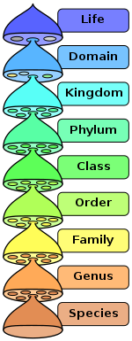

Slide 3
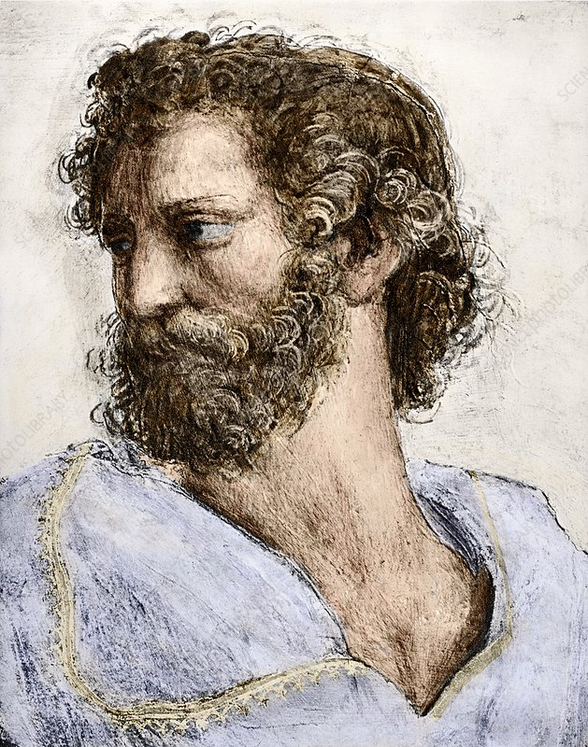


KINGDOMS AND DOMAINS
Higher level classification is a surprisingly dynamic field with a long history
Aristotle

Slide 4


KINGDOMS AND DOMAINS
Higher level classification is a surprisingly dynamic field with a long history
Linnaeus

Slide 5
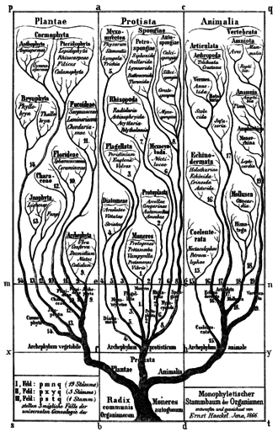
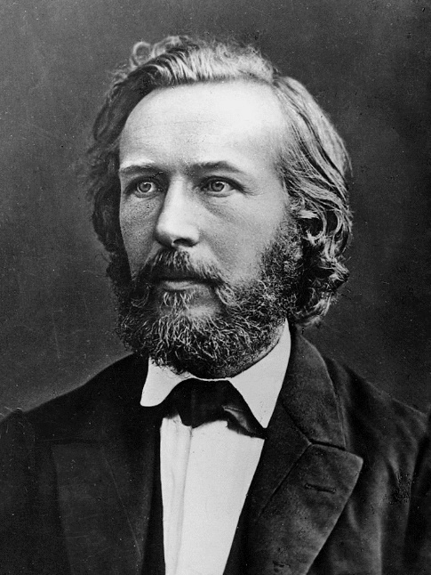
KINGDOMS AND DOMAINS
Higher level classification is a surprisingly dynamic field with a long history
Ernst Haeckel

Slide 6
KINGDOMS AND DOMAINS
Higher level classification is a surprisingly dynamic field with a long history
Two empires with four kingdoms (1938)
Two empires with five kingdoms (1969)
Two empires with six kingdoms (1977)
Three superkingdoms with eight kingdoms (1987)
Three domains (1990)
Two empires with six kingdoms (1998)

Slide 7
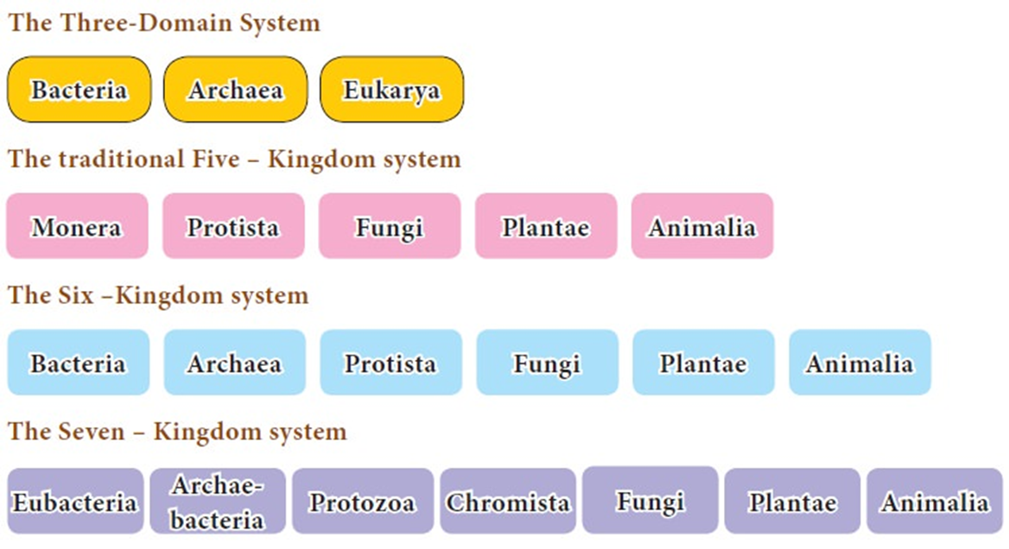
KINGDOMS AND DOMAINS
Higher level classification is a surprisingly dynamic field with a long history

Slide 8
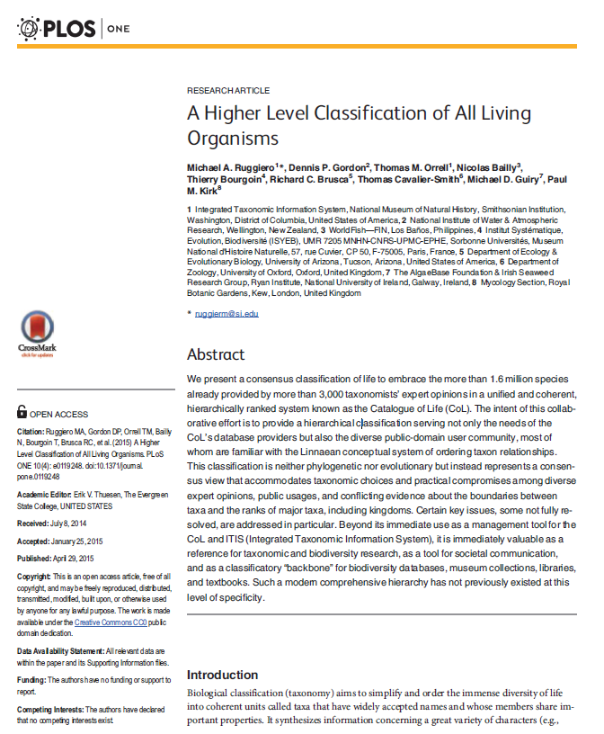
KINGDOMS AND DOMAINS
Higher level classification is a surprisingly dynamic field with a long history

Slide 9
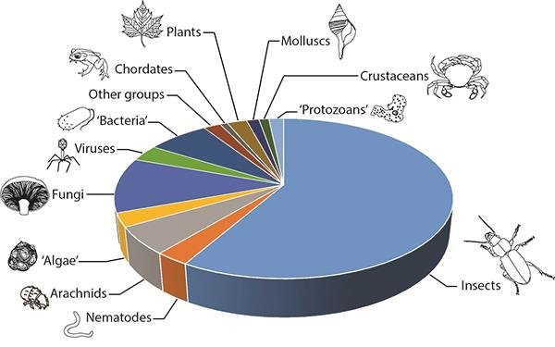
Total Diversity of Organisms

Slide 10
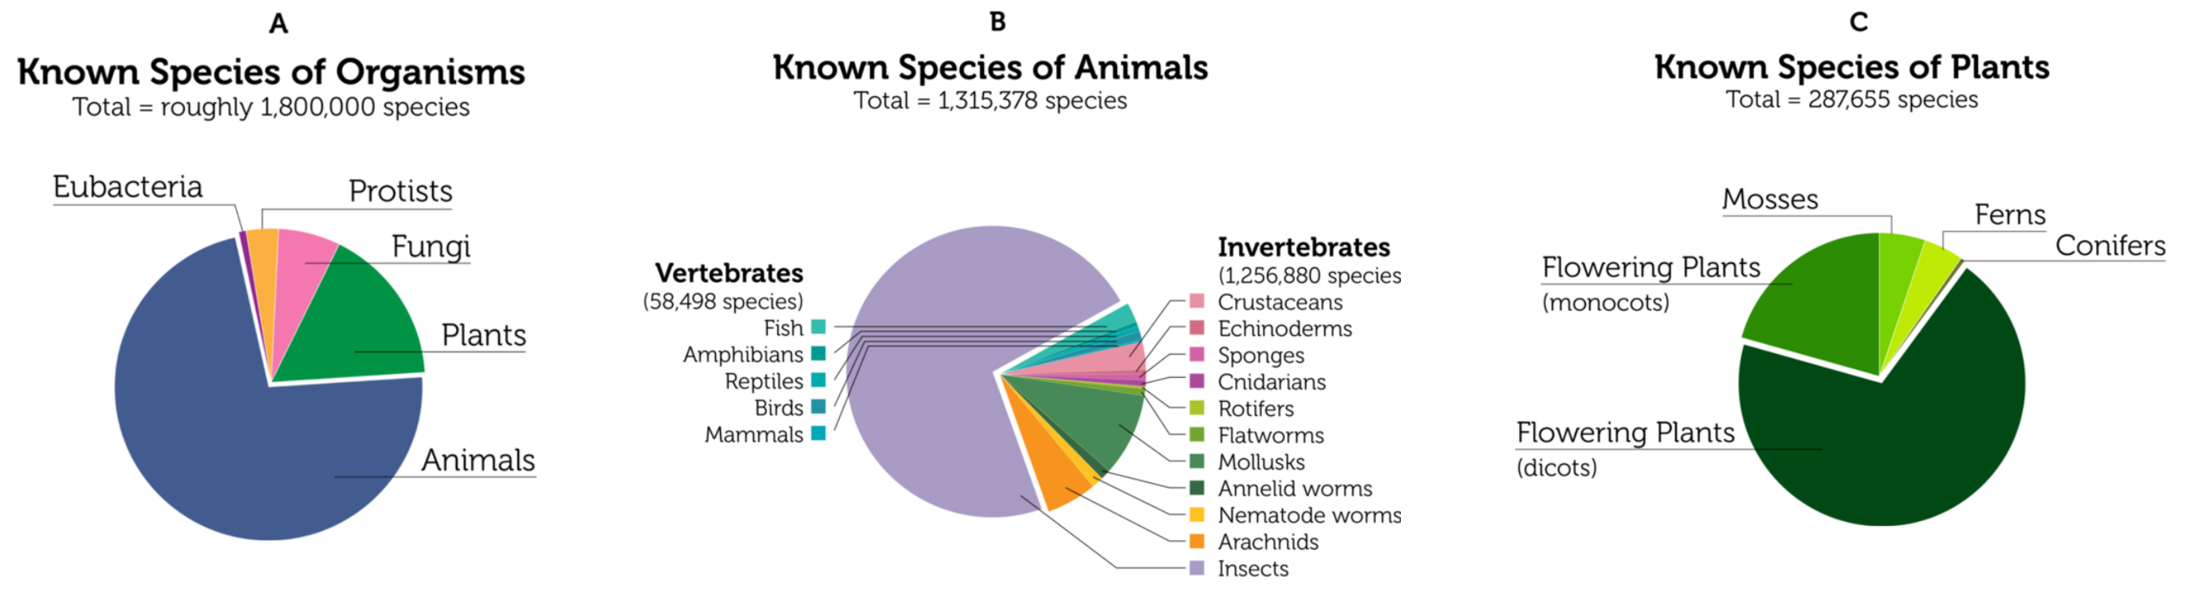
Total Diversity of Organisms

Slide 11
Kingdom Animalia
Multicellular and eukaryotic organisms
1.5 million living animal species have been described but an estimated 7 million
"animal" comes from the Latin animalis, meaning having breath, having soul or living being
Distinguishing features
Consume organic material (heterotrophic)
Breathe oxygen
Motile at some point in their life cycle
Can reproduce sexually, but there are exceptions
Grow from a hollow sphere of cells, the blastula, during embryonic development

Slide 12
Kingdom Animalia

Slide 13
Phylum Arthropoda
Largest phylum in the animal kingdom
~84% of all known animal species
Includes lobsters, crabs, spiders, mites, insects, centipedes, and millipedes
Represented in every habitat on Earth (aquatic, terrestrial and adapted for flight)
Name arthropod means “jointed feet”

Slide 14
Phylum Arthropoda
Distinguishing features
Presence of a jointed skeletal covering composed of chitin (a complex sugar) bound to protein
Lack locomotory cilia, even in the larval stages, probably because of the presence of the exoskeleton
Body is usually segmented
Segments bear paired, jointed appendages

Slide 15
Subphylum Uniramia
Previous classifications had three subphyla of arthropoda were Uniramia, Crustacea and Chelicerata
With Uniramia including;
Hexapoda (insects)
Myriapoda (centipedes and millipedes)
Onychophora (velvetworms)
This grouping was polyphyletic
POLYPHYLETIC: derived from more than one common evolutionary ancestor or ancestral group and therefore not suitable for placing in the same taxon
“it is easiest to say that arthropods are
divided into chelicerates, myriapods and pancrustaceans; it is not acceptable anymore to say that they are divided into chelicerates, myriapods, crustaceans and insects, because crustaceans are paraphyletic and insects are just a subset of Hexapoda.”

Slide 16
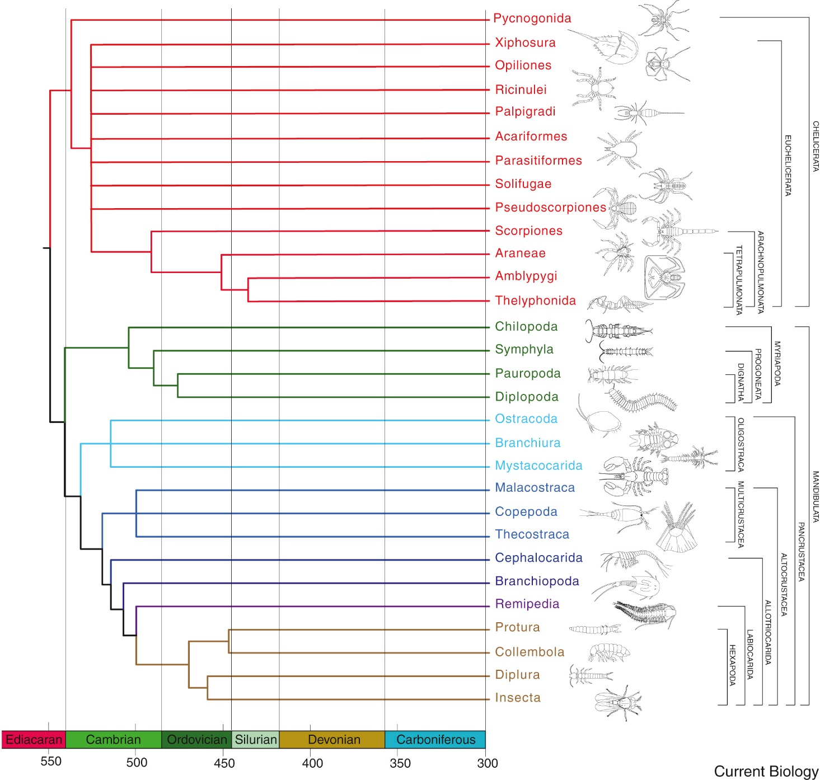
Phylogeny of major arthropod lineages
Giribet & Edgecombe (2019)

Slide 17
Phylogeny of major arthropod lineages
Regier et al (2010)

Slide 18
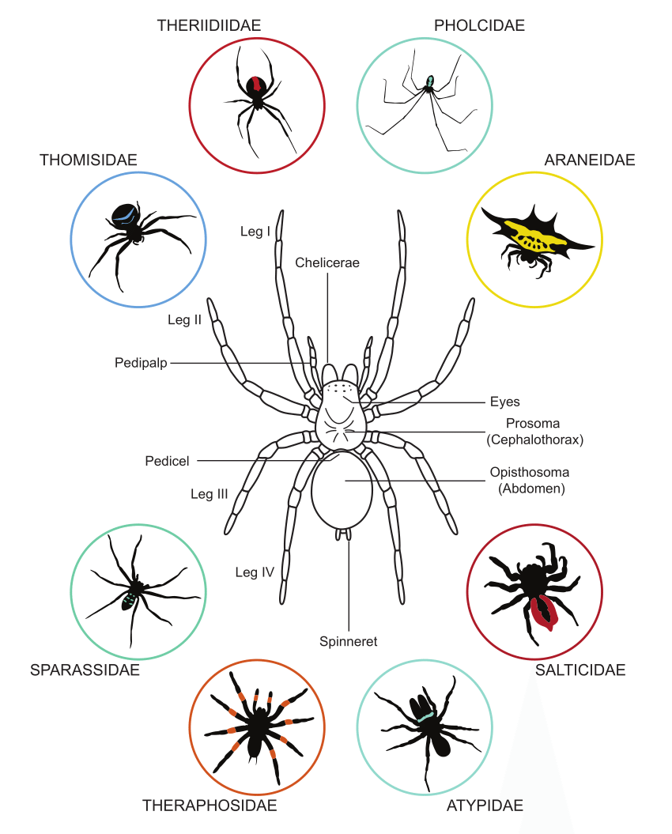
Phylum Arthropoda
Two major monophyletic clades within arthropods with divergence ~ the Precambrian
Chelicerata
ticks and mites, solifuges, spiders, scorpions etc
characterized by “a pair of appendages, generally pincer-like feeding structures, called chelicerae or chelifores and a pair of sensory legs called palps/pedipalps
body divided into ‘prosoma’ and ‘opisthosoma’, four pairs of walking legs, possess venom and silk
Mandibulata
myriapods, insects and many lineages of ‘crustaceans’
presence of biting appendages = mandibles

Slide 19

Phylogeny of major arthropod lineages
Chelicerata

Slide 20
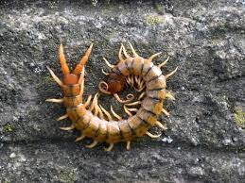
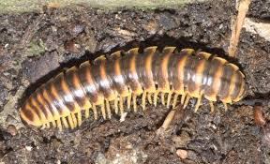
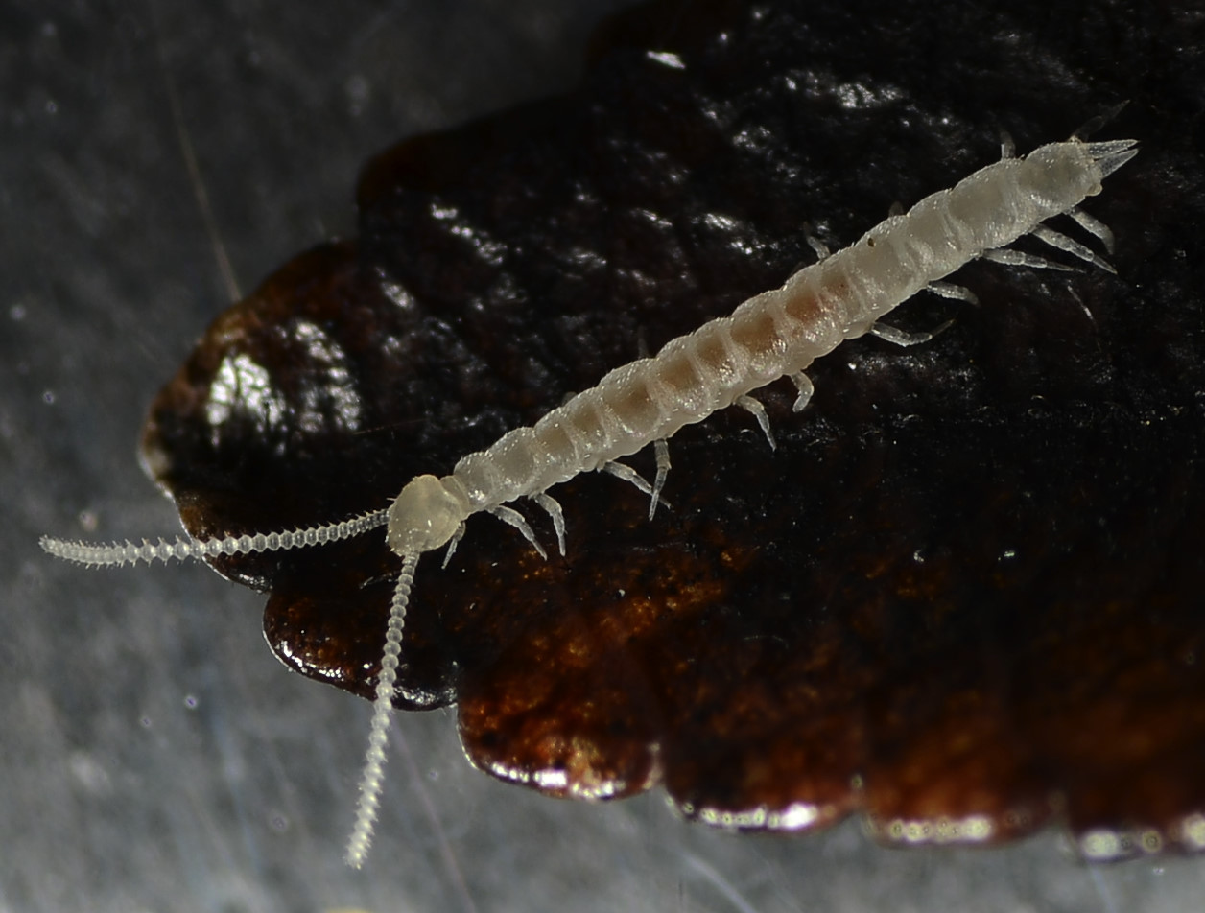
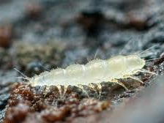
Mandibulata
Divided into two clades that appear to be well supported as monophyletic; Myriapoda and Pancrustacea
Four myriapod classes (sometimes sub-classes)
Diplopoda (millipedes)
Pauropoda
Chilopoda (centipedes)
Symphyla (pseudocentipedes)

Slide 21
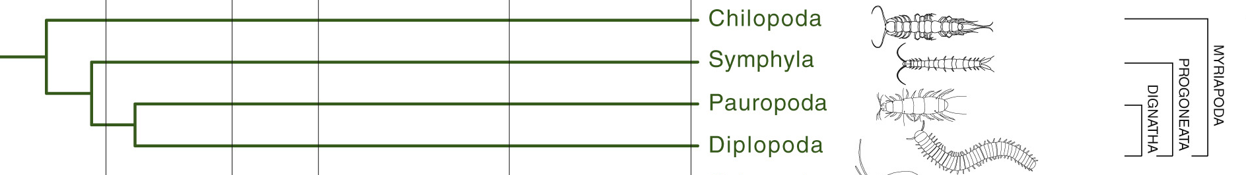
Myriapoda
Chilopoda (centipedes)
Diplopoda (millipedes)
Symphyla (pseudocentipedes)
Pauropoda

Slide 22

Phylogeny of major arthropod lineages
Mandibulata

Slide 23
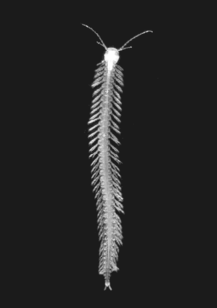
Pancrustacea
PARAPHYLETIC: includes a common ancestor and some, but not all, of its descendants
‘crustaceans’ are a paraphyletic group
Remipedes are most likely sister-taxa to hexapods
Aquatic with sub-tropical to tropical distribution
Blind and unpigmented
Venomous

Slide 24
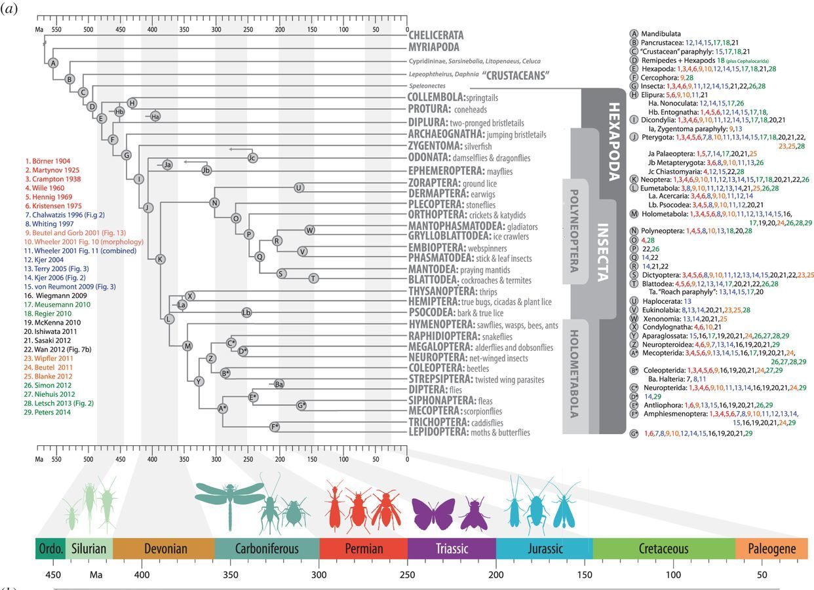
Hexapoda
Insecta + Collembola, Protura, and Diplura
From Kjer (2016), originally Misof (2014)

Slide 25
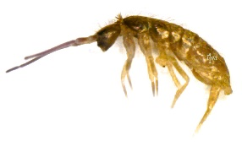
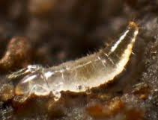
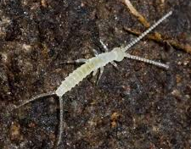
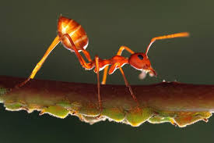
Hexapoda
Collembola
Protura
Diplura
Insecta

Slide 26
Recommended Reading
Giribet & Edgecombe (2019) The Phylogeny and Evolutionary History of Arthropods. Current Biology
Kjer et al. (2016) Progress, pitfalls and parallel universes: a history of insect phylogenetics. J. R. Soc. Interface.
Misof et al. (2014) Phylogenomics resolves the timing and pattern of insect evolution. Science
Schwentner et al. (2017) A Phylogenomic Solution to the Origin of Insects by Resolving Crustacean-Hexapod Relationships. Current Biology
Regier et al (2010) Arthropod relationships revealed by phylogenomic analysis of nuclear protein-coding sequences. Nature
World Remipedia Database http://www.marinespecies.org/remipedia/

